Slide 1
ROUND 1 UNIVERSITY STUDENT CATEGORY
AITEK
AutoMate: Make Your Drive, Make Your Style
Email: chi.tieuchi@hcmut.edu.vn
Hotline: 0703 536 941
Address: HCMUT

Slide 2
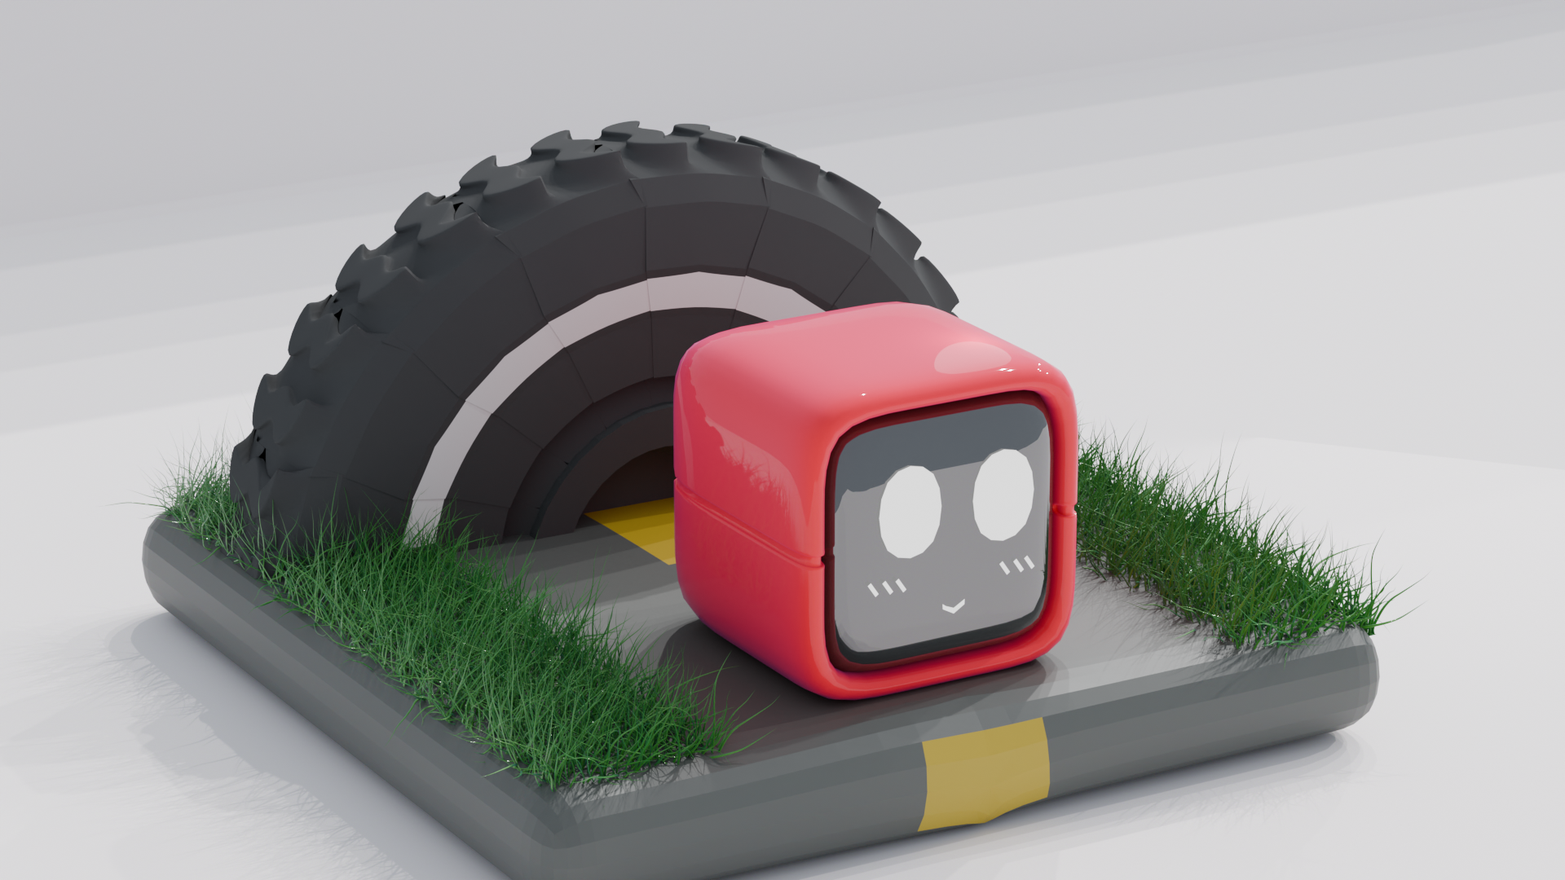
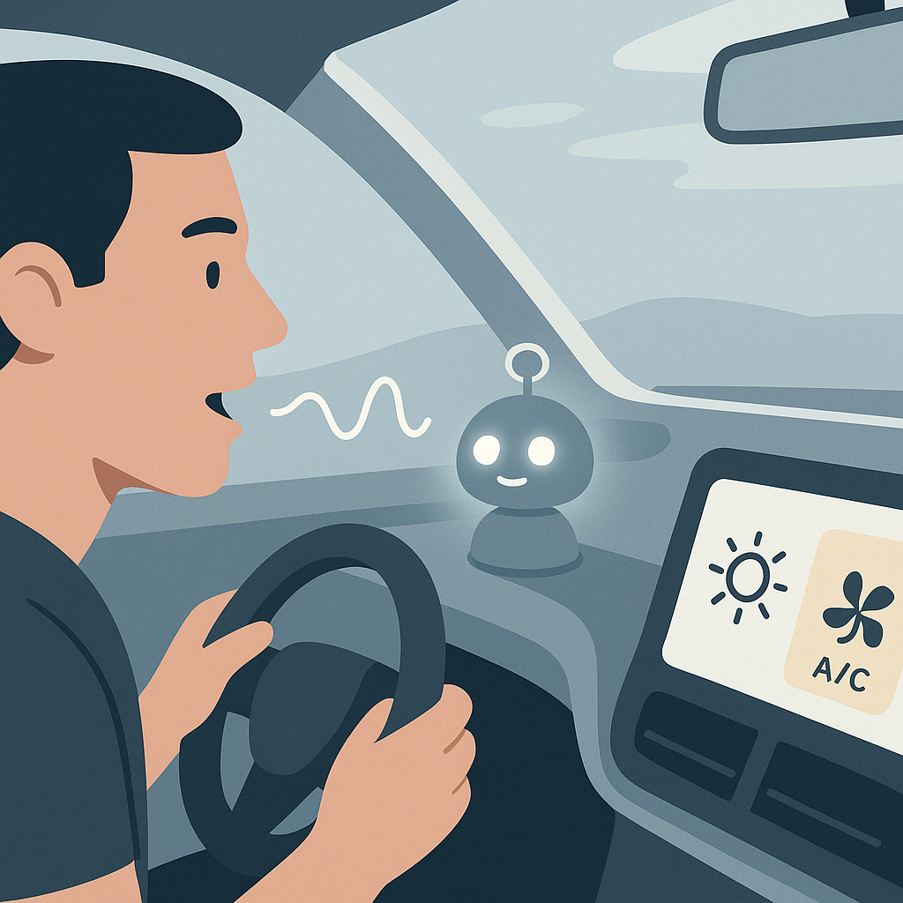
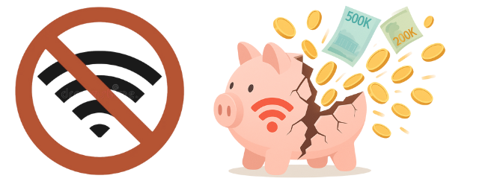

1. PROBLEM / SOLUTION
THE CHALLENGES
OUR SOLUTIONS
Complex in car-system
=> High distraction and safety risk
Enhances Safety: Focused, Hands-free control
MOGI
Online assistants limited by unreliable connectivity
100% Offline Reliability: Works anytime, anywhere
Phone Use Penalties: Legal & Financial Risks
(Decrees 100/2019 & 123/2021 & 168/2024)
Enables Law Compliance & Safer Habits
=> Positive Social Impact: Safer Roads, Greater Tech Accessibility

Slide 3
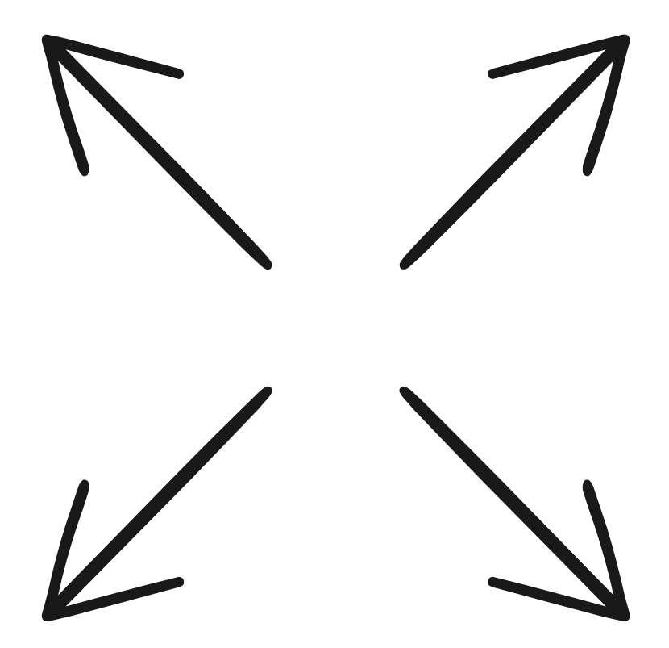
2. INNOVATION
100% Offline Voice Control
Unique “Robot Key” Interface
No internet needed
Work anywhere
=> Enhance Reliability & Better Accessibility
Physical Robot Key
Engaging Interaction
Unique Activation
MOGI
Deep Hardware Integration
Holistic Experience
Direct Hardware Control (CAN Bus)
Beyond App-Level Control
Embedded Vehicle Control
Safety + Style + Simplicity
=> Affordable & Engaging Innovation

Slide 4
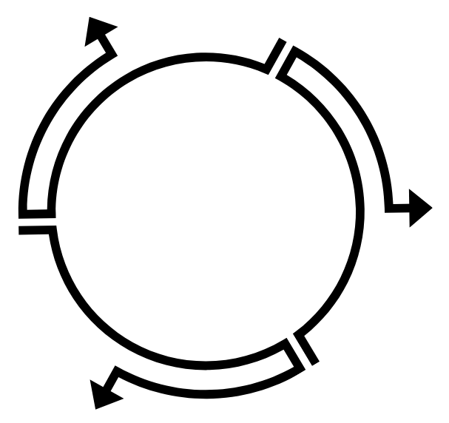

3. MARKET FEASIBILITY
Market Needs
Target Market
Urgent Need for Enhanced Driving Safety
Demand for Reliable Offline Solutions
Desire for Simplified In-car Interaction
Tech-Savvy Urban Drivers
Connectivity-Challenged Commuters
Vehicle Retrofit Seekers
Ride-Hailing Professionals
MOGI
TAM ~ 580M $
Supportive Trends
Rising Safety Consciousness
Smart Car Adoption & Personalization
Growth of Edge AI & Offline Technology
SAM ~ 71M $
SOM
2%

Slide 5
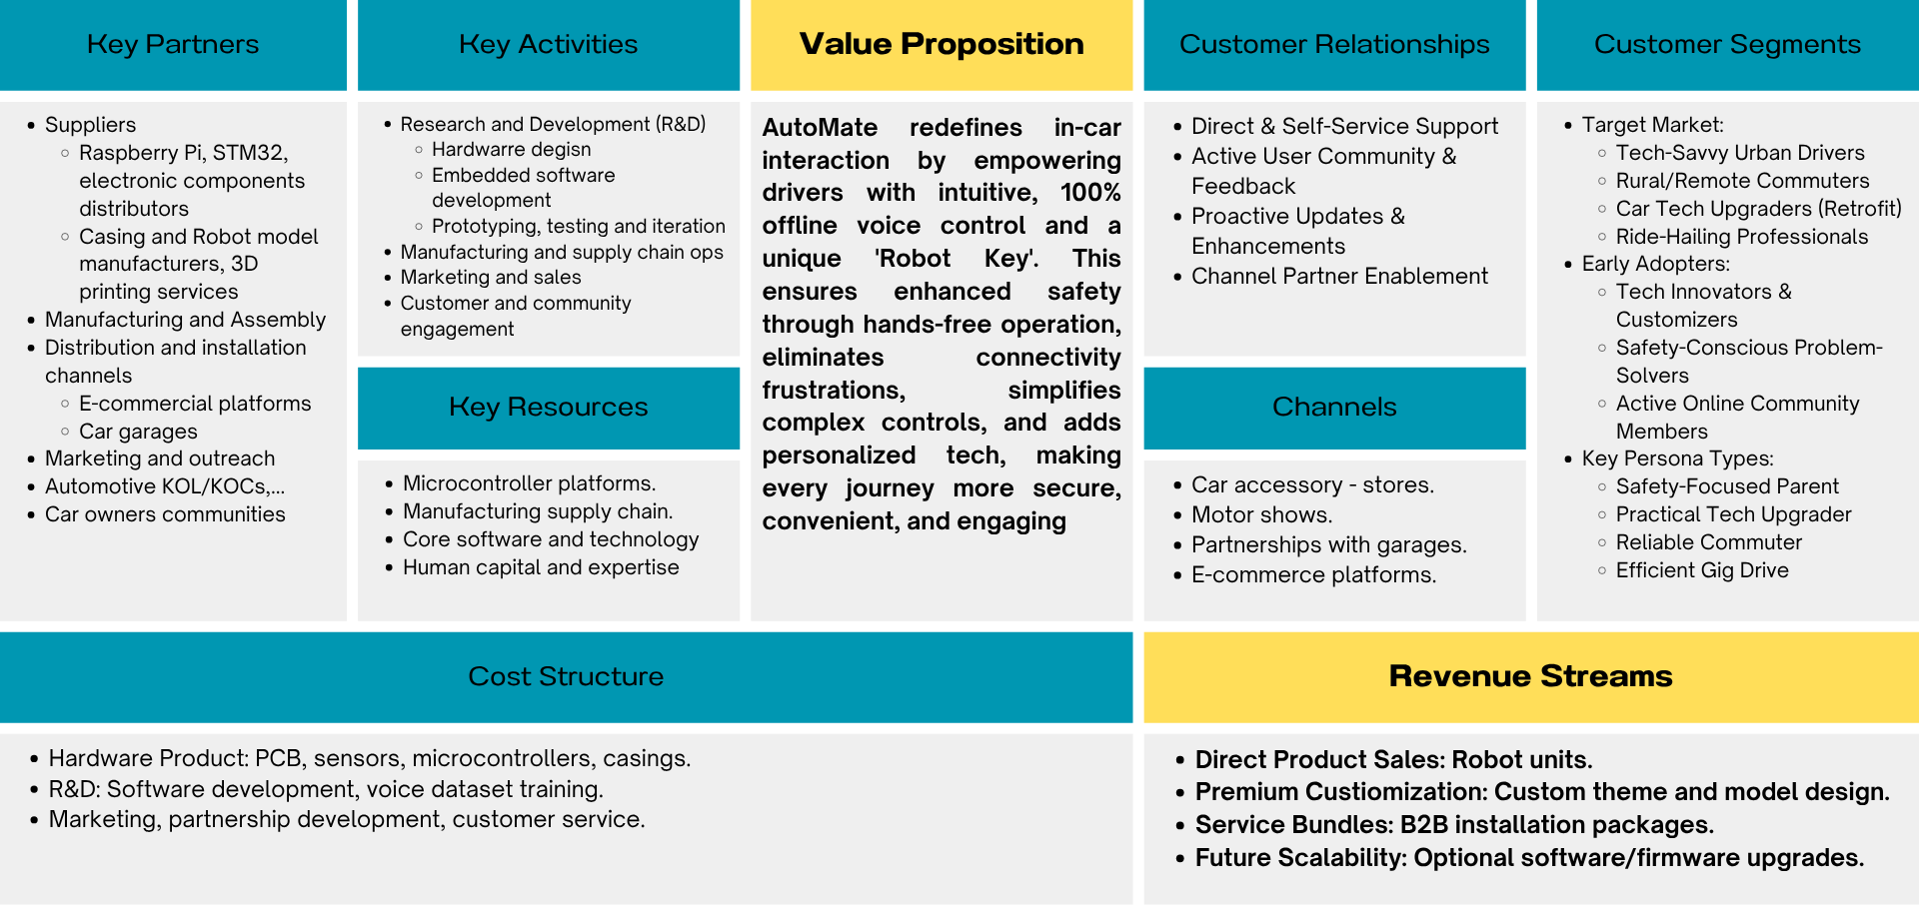
4. BUSSINESS MODEL

Slide 6
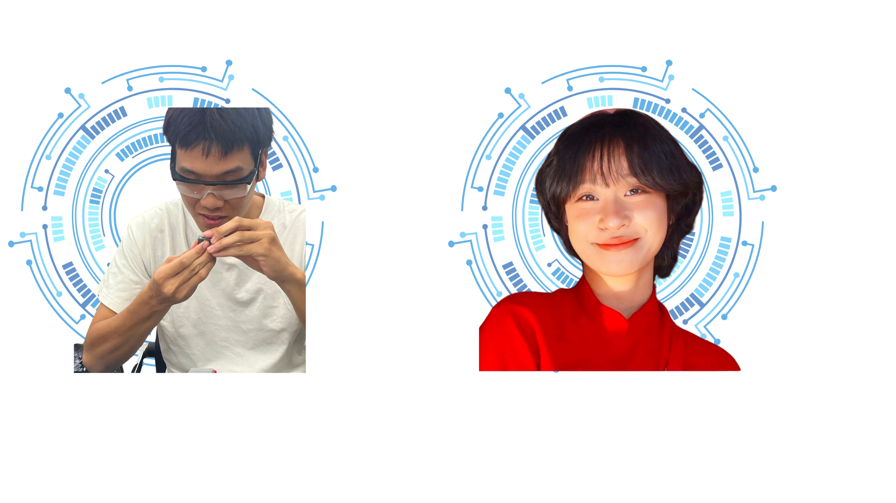
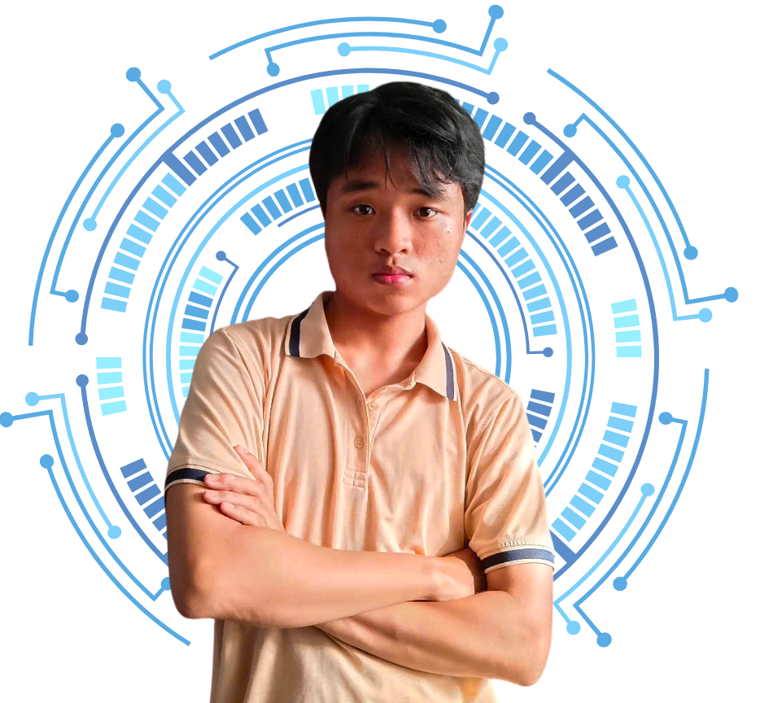
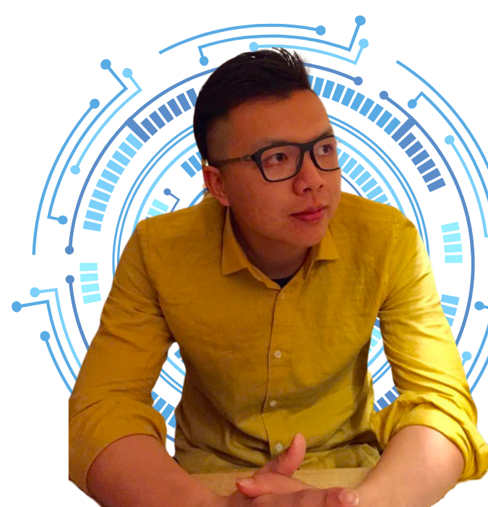
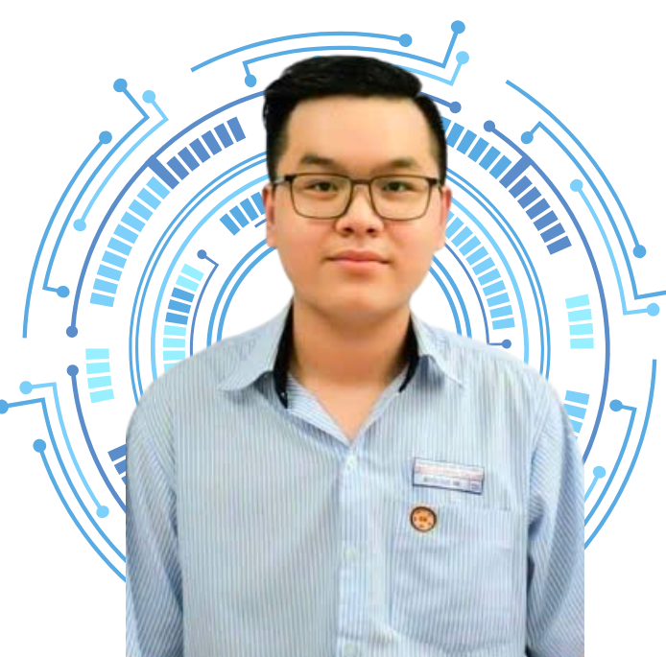
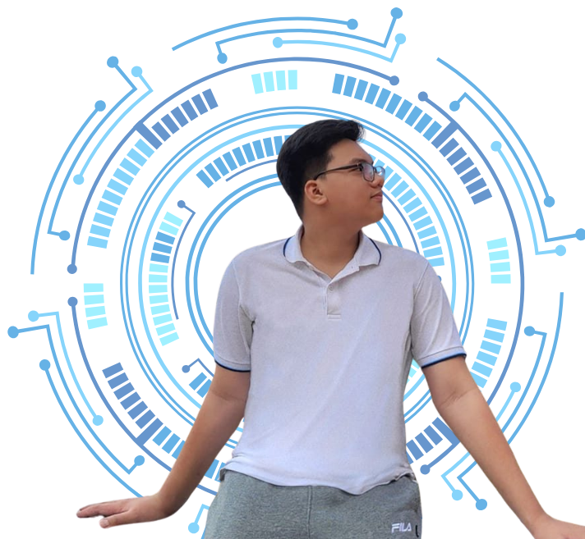
5. TEAM & ADVIDORS
AITEK: Dedicated Automotive Engineering Students from HCMUT
Team Leader: Tieu Chi
Embedded Software Development
Vehicle Interface Integration
Thuy Tien
Hardware Developer
Minh Duy
Software Developer
Mentor: Mr. P.T Dang Quang
Lecturer at the Faculty of Transportation
Guidance: Transportation Engineering & Electronic Field
Nang Tri
Team Spokesperson
Tien Dung
Market Analyst

